Slide 1
Great Energy Predictor for Buildings
Kaggle competition by ASHRAE

Slide 2
Agenda
04
03
02
01
Further Improvements
Machine Learning Deployment
Kaggle competition Great Energy Predictor
Machine Learning Applications in the Built Industry

Slide 3






Machine Learning Applications in the Built Industry
Digital Technologies
Save up to 25% in energy bills and reduce your carbon footprint
Energy Engineering
Real-time analytics / FDD and ML models insights with BMS data
Objectives
Minimize Critical Equipment Downtime
The Global Goals for Sustainable Development

Slide 4
Machine Learning Applications in the Built Industry
A
C
B
D
Identify Anomoaly
Optimize Energy Usage
Abnormal Readings from IoT sensors / Power surging etc
Deviations can be analyzed in real time for insights and remedial measures
Optimize Setpoint
Predictive Mainteance
Optimize controls based on real-time/ envionmental factors
Improve predictive maintenance scheduling

Slide 5

ASHRAE Great Energy Predictor III
The American Sociery of Heating, Refrigerating and Air-Conditioning Engineers
The Great Energy Predictor III from ASHRAE aims to develop counterfactual models to predict building energy usage based on historic data and observed weather.
Goal to improve estimations of these energy-saving initiatives, allowing large-scale investors and financial institutions to be more willing to invest in building efficiencies.

Slide 6




Competition Goal: To build a regression model that predicts metered building energy usage meter
Chilled Water
Electricity
Water-Cooled Chiller System
Absorption Chiller
HVAC
Lightings
Ventilation
Plug Loads
Hot Water
Steam
Washing
Showering
Drinking
Sterilization for medical and food processing facilities

Slide 7
Datasets
The dataset includes three years of hourly meter readings from over
one thousand buildings at several different sites around the world.
Train dataset (2016)
20 millions historical usage data from around 1600 buildings,
16 different sites and 4 different meters
Test Dataset (2017-2018)
42 millions historical usage data from same buildings
but different period of time
Weather Data
Building Metainfo
Meters historical usage
Merged Data (3 years timeframe)
Train
Test
Notes:
In the case of RMSE, the presence of outliers can explode the error term to a very high value. But, in the case of RMLSE the outliers are drastically scaled down therefore nullifying their effect.
In simple words, more penalty is incurred when the predicted Value is less than the Actual Value. On the other hand, Less penalty is incurred when the predicted value is more than the actual value. This is especially useful for business cases where the underestimation of the target variable is not acceptable but overestimation can be tolerated.

Slide 8
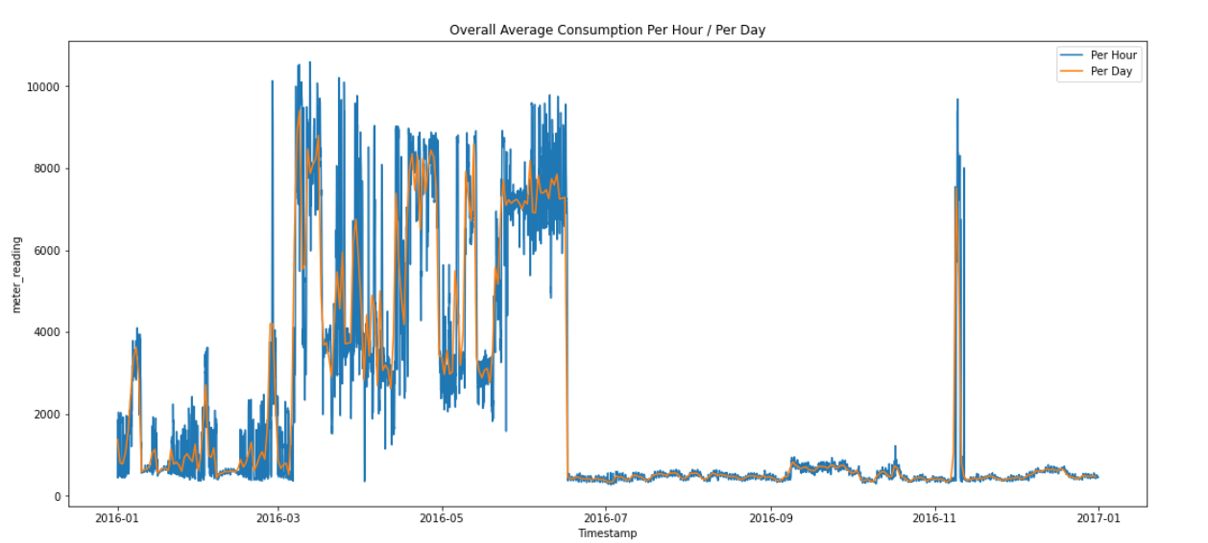
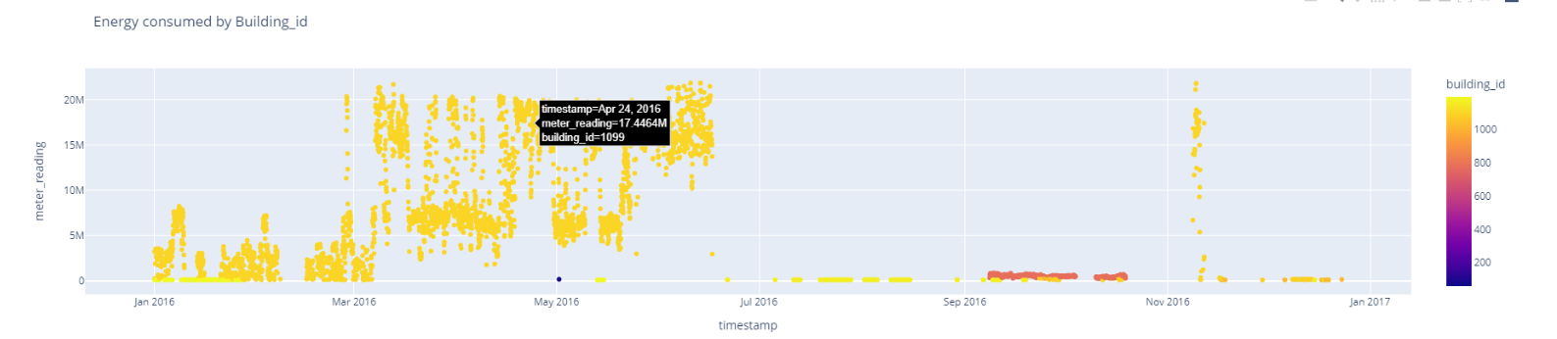
Dataset Preprocessing: Identifying outlier building
Notes:
Building 1099 is a clear anomaly (refer to plot below). Given its GFA, the building is unlikely to consume so much energy. It's possible that the meters aren't working properly or that the meter readings are cumulative.

Slide 9
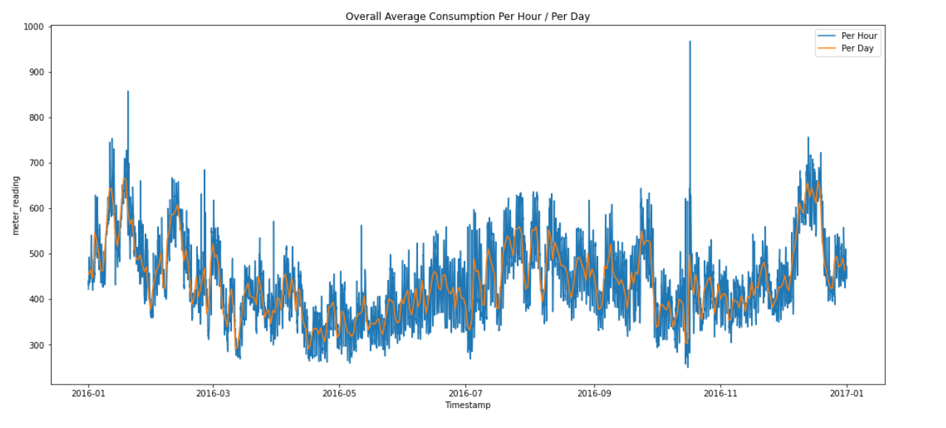
Dataset Preprocessing: Removing Building with anomaly consumption
Notes:
Building 1099 is a clear anomaly (refer to plot below). Given its GFA, the building is unlikely to consume so much energy. It's possible that the meters aren't working properly or that the meter readings are cumulative.

Slide 10
Dataset Preprocessing
Filling in missing temperature data with linear interpolation is a simple but effective approach to improve model performance
Missing Data
Anomaly removal
With some domain expertise in meters and simple intuition, abnormal readings for the four meters were detected and dropped
Smoothed temperature data
Rolling averages are useful for finding long-term trends otherwise disguised by occasional fluctuations
Feature Engineering
Add in feels like temperature, wind chill, and heat index
Notes:
With some domain expertise in meters and simple intuition, abnormal readings for the four meters were detected and dropped
Remove long streaks of constant 0 readings from electric meters
Identifying abnormal hot water/steam and chilled meter consumption in each facility during the winter and summer seasons
A transformation of the target variable that brings it closer to a normal distribution

Slide 11
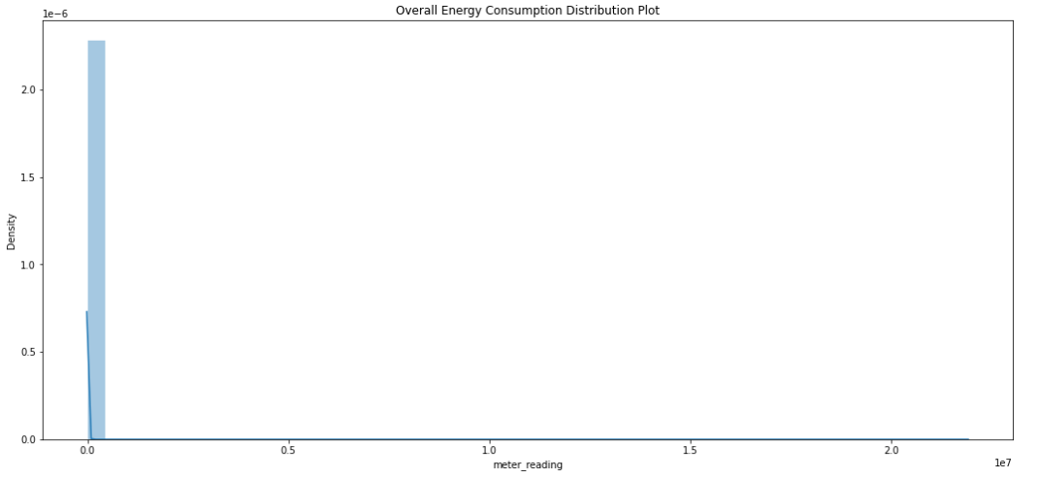
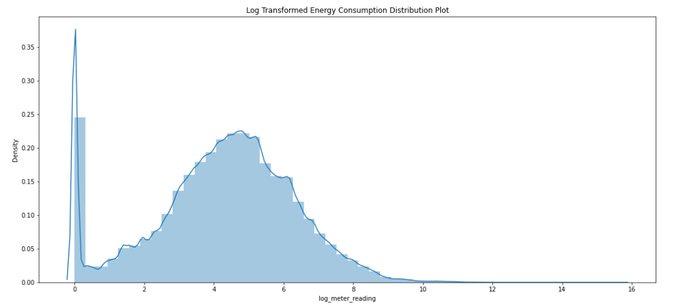
Dataset Preprocessing
Before Logarithm Transformation
After Logarithm Transformation
Notes:
With some domain expertise in meters and simple intuition, abnormal readings for the four meters were detected and dropped
Remove long streaks of constant 0 readings from electric meters
Identifying abnormal hot water/steam and chilled meter consumption in each facility during the winter and summer seasons
A transformation of the target variable that brings it closer to a normal distribution

Slide 12
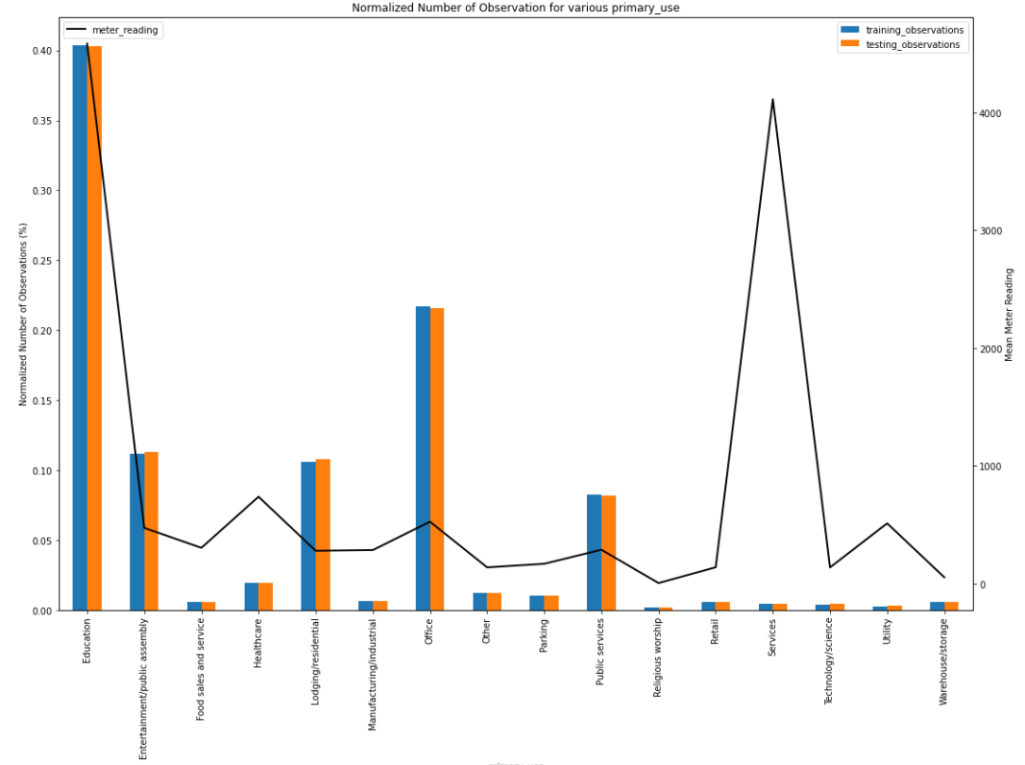
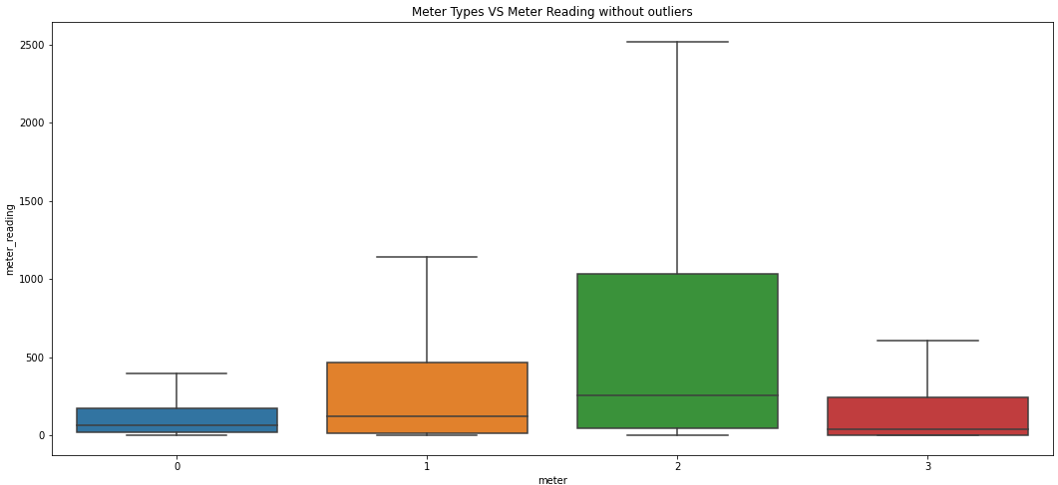
Exploratory Data Analysis
Education, service facilities consume most energy
Meter 2: steam consume most energy, followed by Meter 1: chilledwater
Notes:
Building 1099 is a clear anomaly (refer to plot below). Given its GFA, the building is unlikely to consume so much energy. It's possible that the meters aren't working properly or that the meter readings are cumulative.

Slide 13
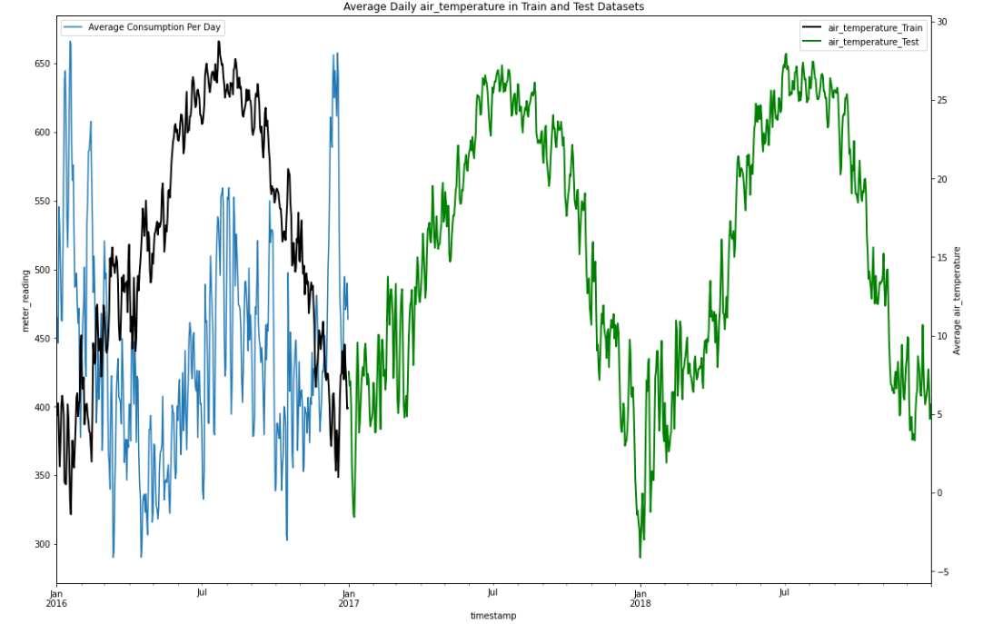
Exploratory Data Analysis
Increased usage throughout the summer (June-Sept) and winter (December-March) seasons
Notes:
Building 1099 is a clear anomaly (refer to plot below). Given its GFA, the building is unlikely to consume so much energy. It's possible that the meters aren't working properly or that the meter readings are cumulative.

Slide 14
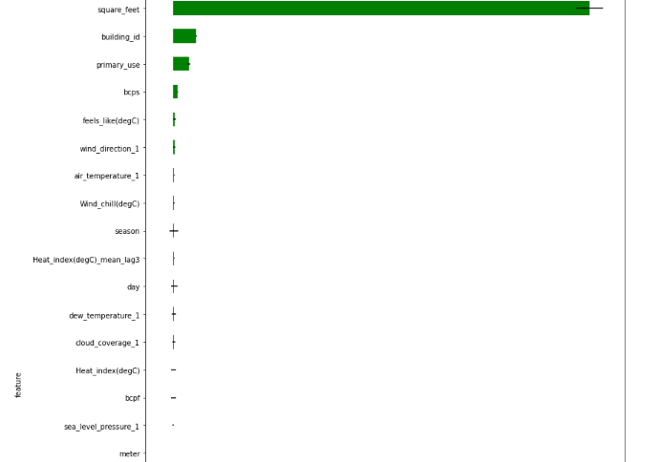
Feature Selection
Using Leave One Feature Out Analysis
The top features are square feet, building id, primary use, and building counts per site.
Notes:
Building 1099 is a clear anomaly (refer to plot below). Given its GFA, the building is unlikely to consume so much energy. It's possible that the meters aren't working properly or that the meter readings are cumulative.

Slide 15
Training Pipeline
Group Kfolds by Building
Training Dataset
Preprocessing
Train Set without Leak
GRUs
XGB
Weighted-average Ensembling
Final Model Submission (Kaggle score 1.197 RMSLE)
Notes:
Building 1099 is a clear anomaly (refer to plot below). Given its GFA, the building is unlikely to consume so much energy. It's possible that the meters aren't working properly or that the meter readings are cumulative.

Slide 16
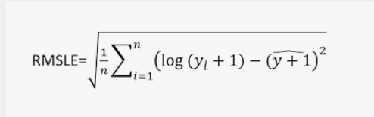
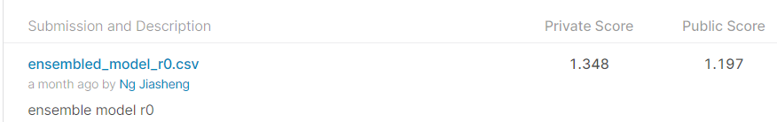
Competition metric: Root Mean Squared Logarithmic Errror
Unique Properties:
Robustness to the effect of the outliers
RMSLE incurs a larger penalty for the underestimation of the Actual variable than the Overestimation.
Notes:
In the case of RMSE, the presence of outliers can explode the error term to a very high value. But, in the case of RMLSE the outliers are drastically scaled down therefore nullifying their effect.
In simple words, more penalty is incurred when the predicted Value is less than the Actual Value. On the other hand, Less penalty is incurred when the predicted value is more than the actual value. This is especially useful for business cases where the underestimation of the target variable is not acceptable but overestimation can be tolerated.

Slide 17
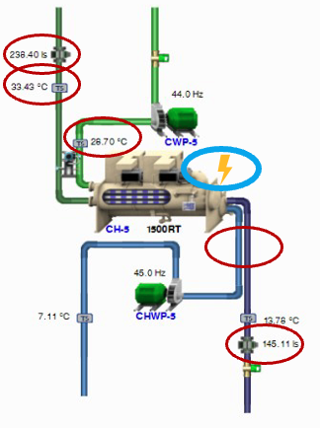



Use Case 1: Chiller Plant Predictive Analytics Mixed-building Singapore
Dataset Summary:
Dataset timeline: 01/01/2019 – 15/03/2019
Training period: 2.5 months
Logging interval: every 1 minute
Weather Normalization: No
Independent Variables Selected:
Chilled Water Flow
Chilled Water Return-Supply Temp
Condenser Water Flow
Condenser Water Supply-Return Temp
Target Variable: Dependent Variable
Chiller Power Consumption

Slide 18
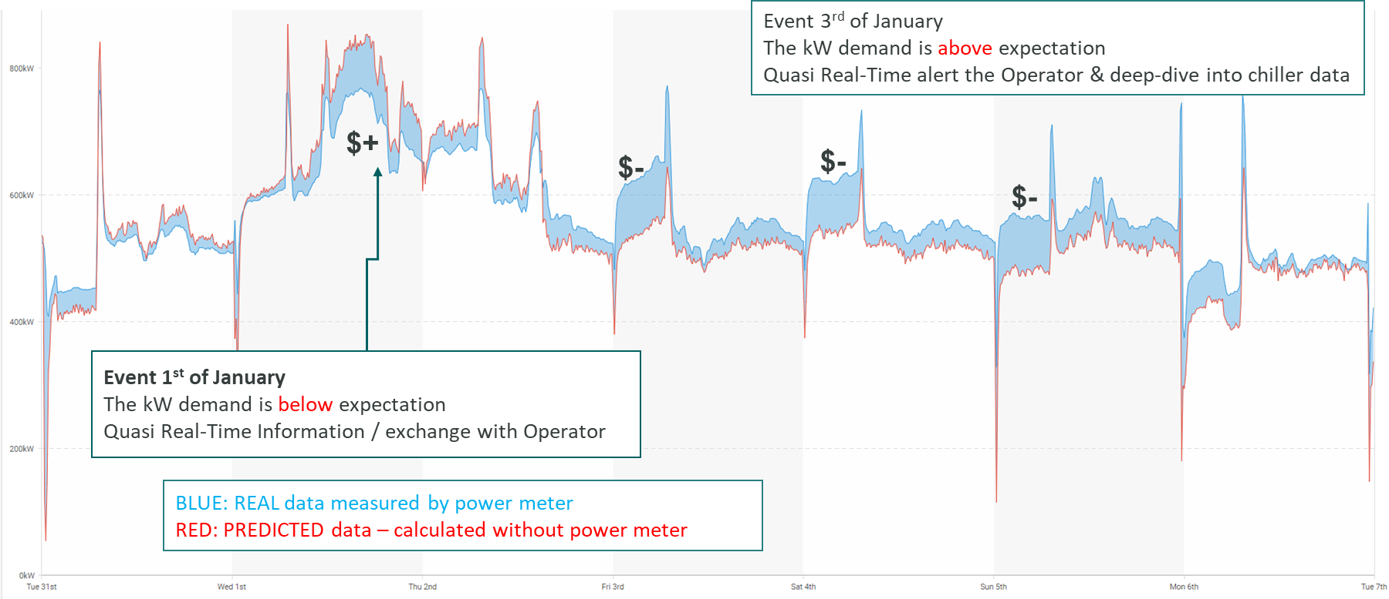
Use Case 1: Chiller Plant Predictive Analytics Mixed-building Singapore (Infographics)

Slide 19
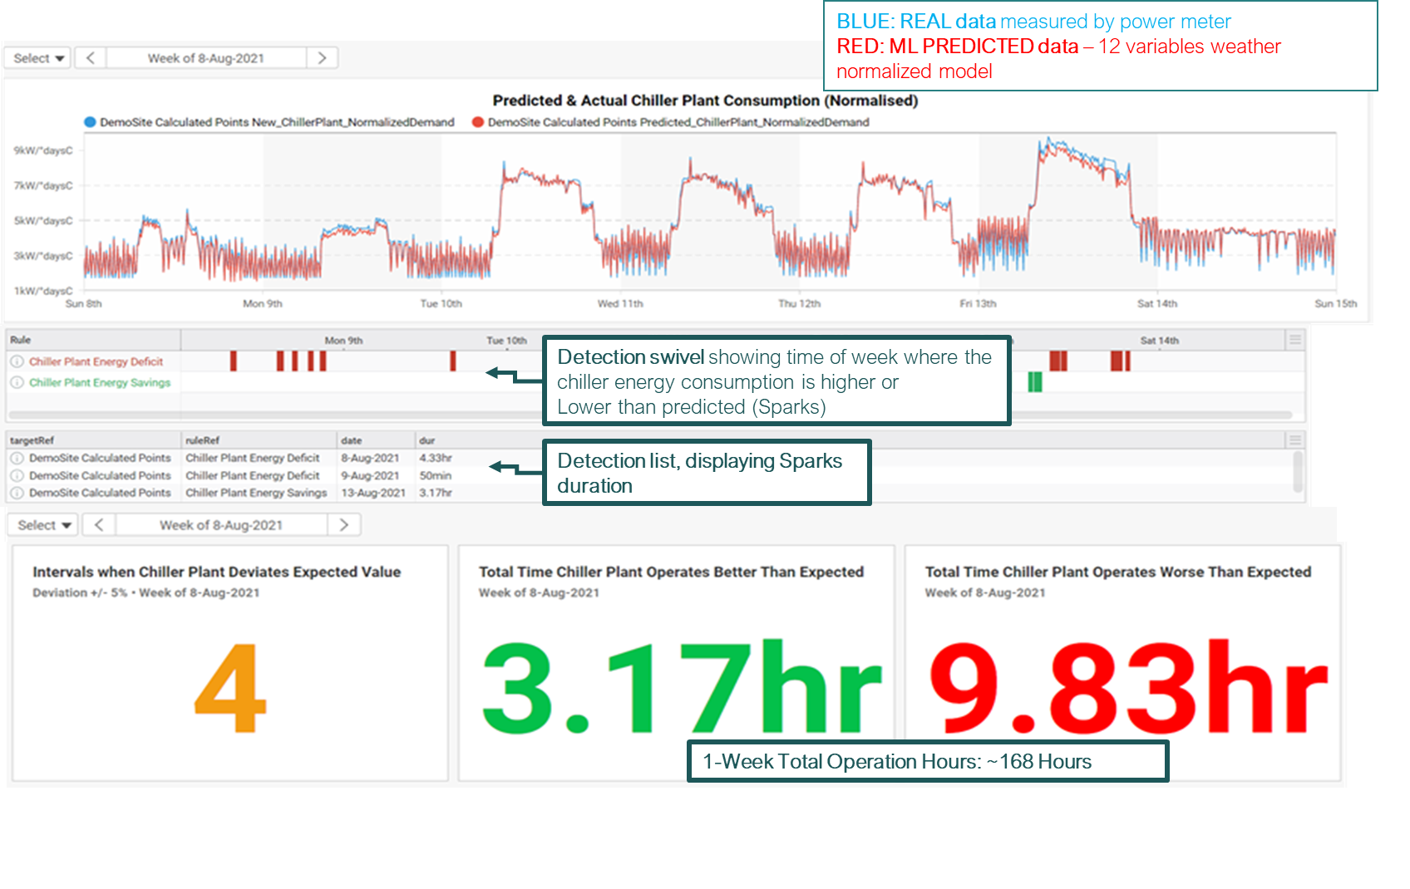
Use Case 1: Chiller Plant Predictive Analytics Mixed-building Singapore (Infographics)

Slide 20
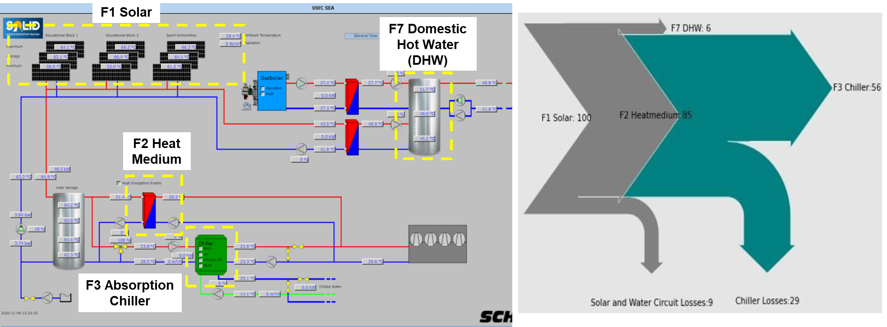
Use Case 2: Solar Thermal & Absorption Chiller Predictive Analysis (Solar Thermal System Energy Flow Diagram)

Slide 21
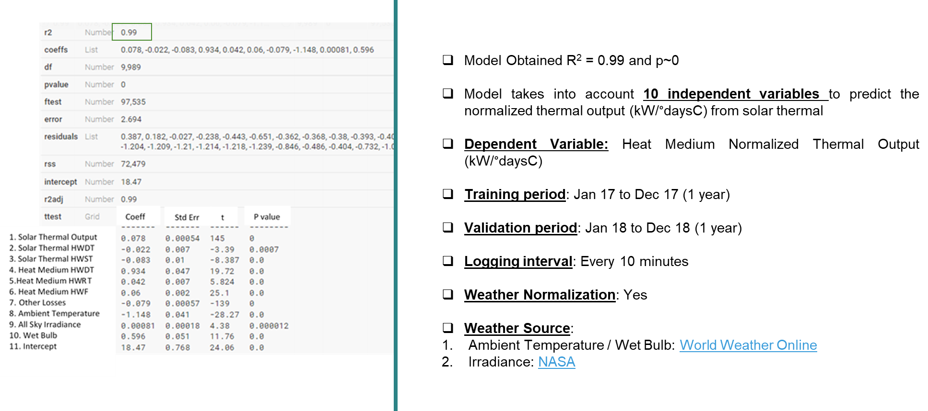
Use Case 2: Solar Thermal & Absorption Chiller Predictive Analysis (Model KPI - Predicting F2 Normalized Thermal Output)

Slide 22
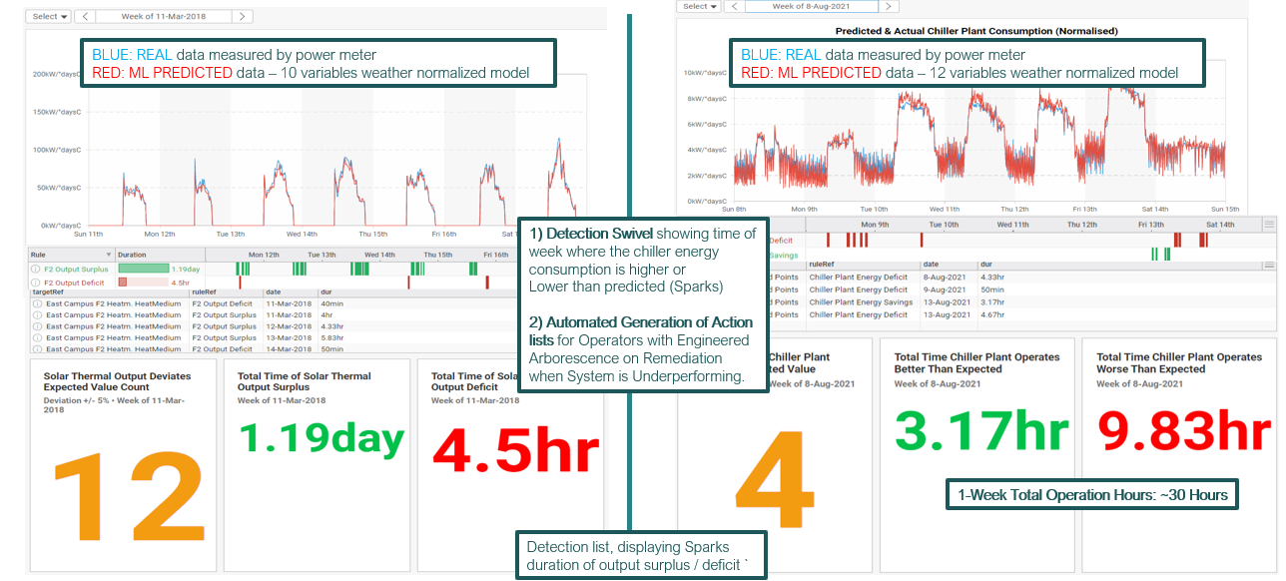
Use Case 2: Solar Thermal & Absorption Chiller Predictive Analysis (Infographics)

Slide 23
Further Improvements
01 | Remove consumption spikes that are difficult to forecast, making the prediction more volatile
02 | Use first and second differentiation of temperature data to make non-stationary data stationary and add rate of change information to the model
03 | One hot encode building_id and site_id before modeling (computationally expensive)
04 | Experiment with lagged weather features and how it affects the model's success metrics
05 | Experiment relations of existing features and target variable (prediciting kwh/ft2 instead)

Slide 24
To Divya , Samantha Shao Quan, Ben
Thanks for making learning fun!

